Slide 1


Team 30: Smart Pest Repeller
Bi-Weekly Update 3 Andrew Albritton
Melquisedec Ordonez
Michael McNeil Sponsor: Peng Hao Huang TA: Eric Robles
Notes:
Michelle

Slide 2
Project Summary
Most outdoor areas, whether agricultural, recreational, or communal, utilize pest control. Current pest control methods on the market often make consumers compromise between what is effective and what is safe for the environment. Pesticides can be highly effective but also dangerous for any organisms that are not the targeted pest. The other commercially available option is ultrasonic emitters. These have the limitation of only being able to target one type of pest at a time due to limited frequency emission.
Our solution to this problem is to make a more versatile ultrasonic emitter system that can have multiple different pest responses using a machine learning identification system. With this system the desire is to have the effectiveness of a more harsh method such as pesticides without the environmental drawbacks.
Notes:
Kyle

Slide 3
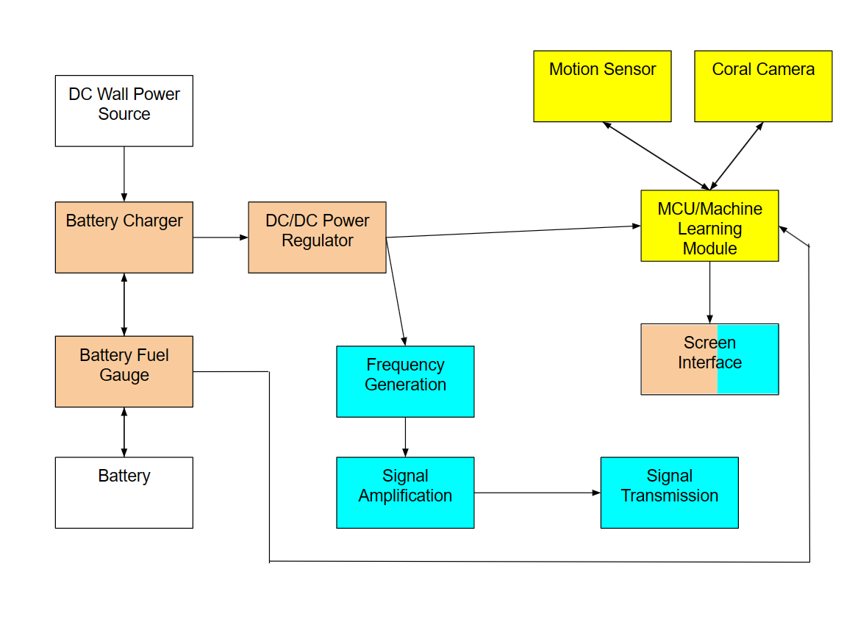
Project/Subsystem Overview
Michael - Orange Andrew - Yellow Mel - Blue Purchased - White
Notes:
Eric

Slide 4
Project Timeline
Subsystem Designs and Testing (was to complete 2/23, work ongoing) | Integration of power subsystem and MCU (to complete by 3/3) | Integration of detection and emitter subsystems (to complete by 3/3) | Final Integration (to complete by 3/10) | System Test (to complete by 3/25) | Validation (to complete by 4/8) | Demo and Report (to complete by 4/15)
Notes:
Eric

Slide 5
Michael McNeil
Accomplishments since last update 15 hrs of effort | Ongoing progress/problems and plans until the next presentation
-Redesigned power system PCB assembled and continuity tested | On-going functional testing of subsystem Integration with MCU and emitter subsystem to be done by next review

Slide 6
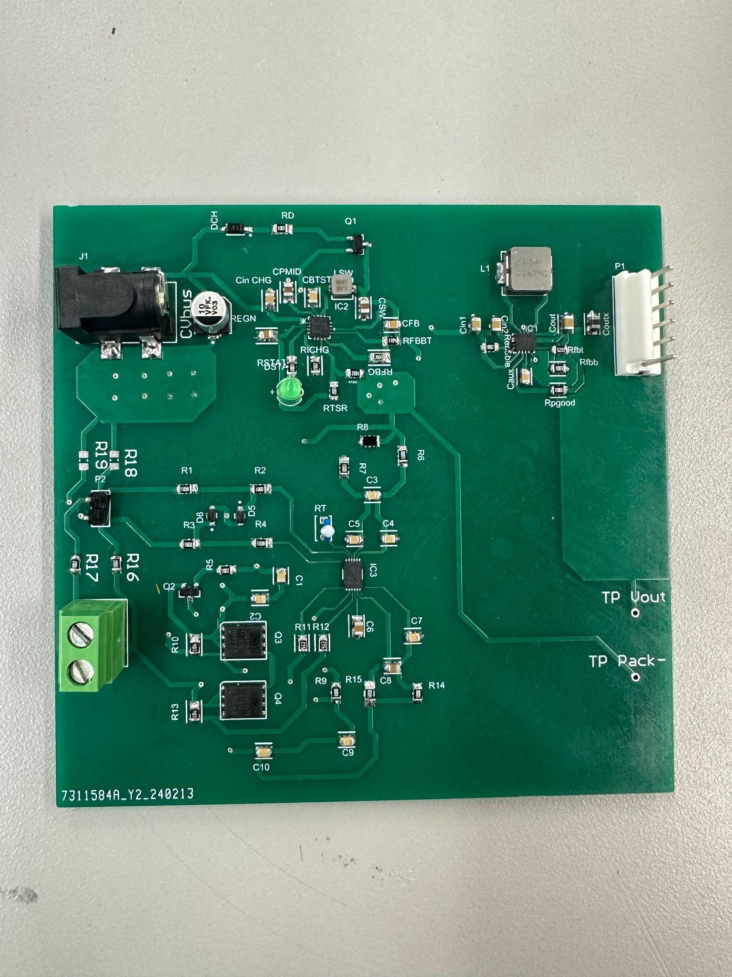
Michael McNeil
Board Improvements:
-Changed battery charger IC
-Fixed grounding issues
-Increased passive component size for easier assembly and testing (0402s to 0805s)
To be done in coming weeks:
-Subsystem functionality testing for charger,FG, and regulator
-Integration of I2C communication with MCU
-Designing functional system tests with rest of group for final integration testing

Slide 7
Andrew Albritton
Accomplishments since last update 35 hrs of effort | Ongoing progress/problems and plans until the next presentation
Hyperparameters for new optimizer have been chosen and tested with several training runs Part order has been sent in to replace Coral Dev Board with Jetson Nano | Model’s dataset will be changed from boxed labeling to polygonal labeling and rebalance validation/train/test image count. Move control files to Jetson Nano and adjust GPIO config. Begin/Complete Integration with power subsystem Begin integration with emitter subsystem Return code to original PyTorch from current Tensorflow

Slide 8
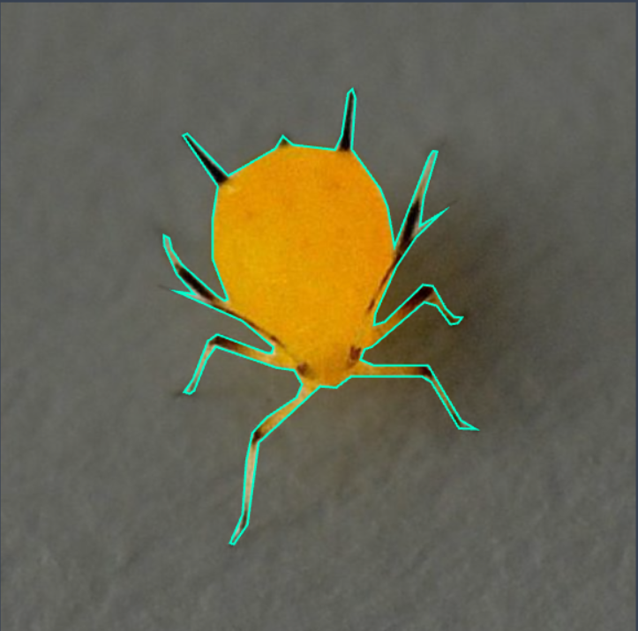
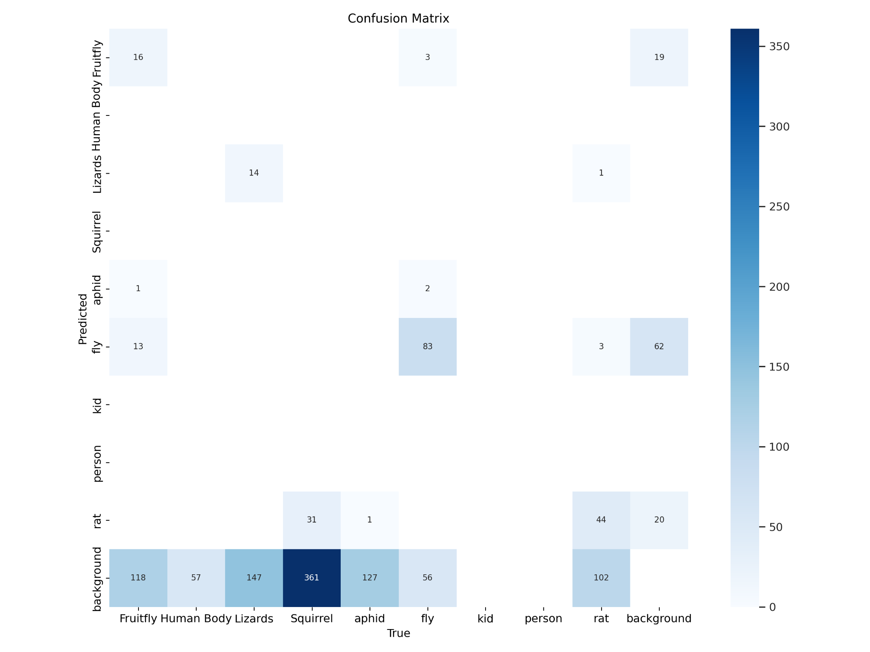
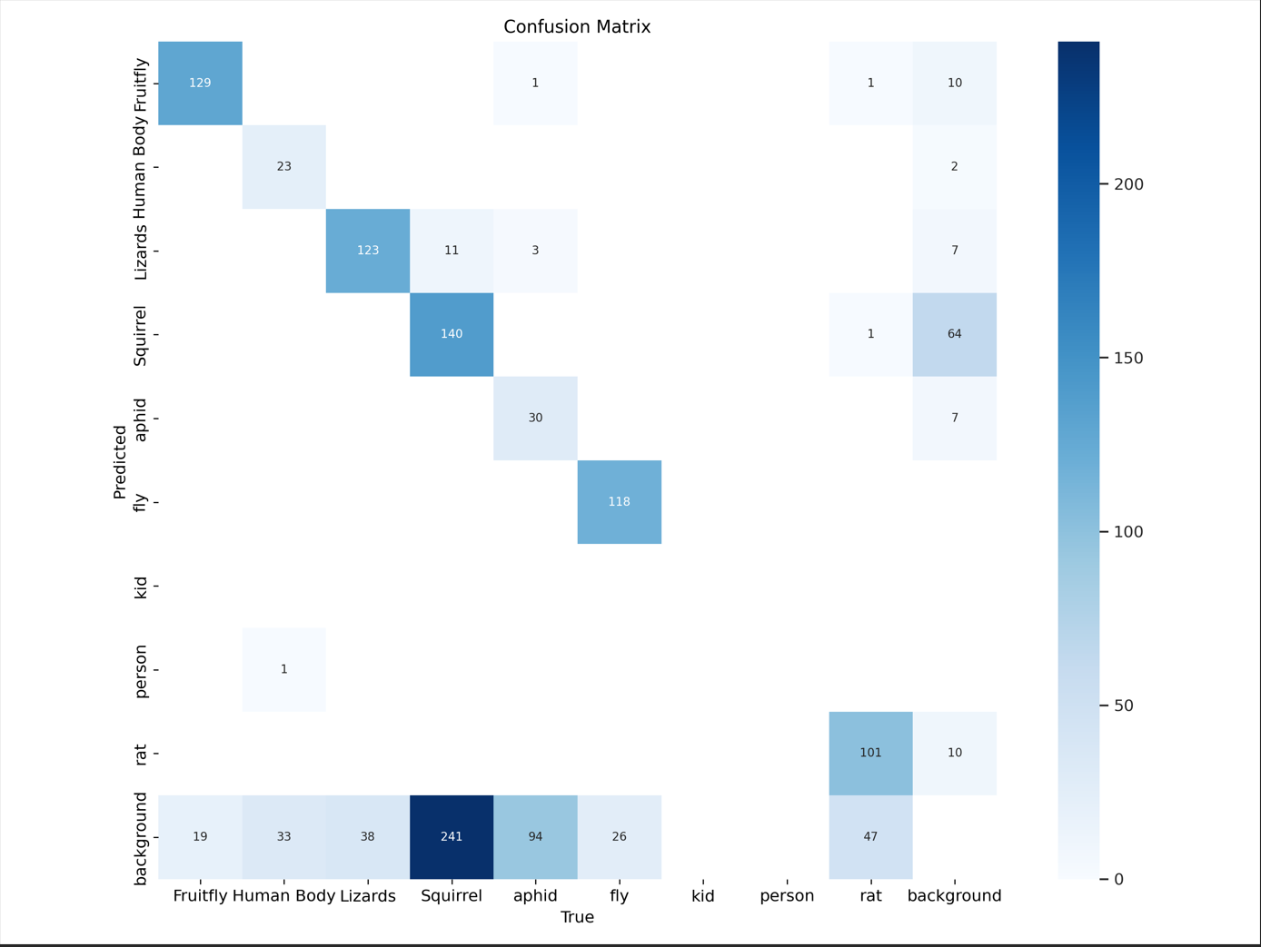
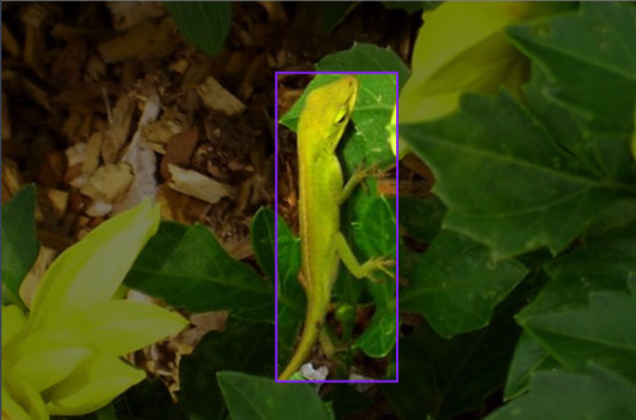
Andrew Albritton

Slide 9
Melquisedc Ordonez
Accomplishments since last update 15 hrs of effort | Ongoing progress/problems and plans until the next presentation
PCB ordered(along with backup board) | Complete integration from arduino based C++ control over to new Jetson Nano interface on python(on backup board for now). Complete integration with power subsystem. Begin integration of screen UI with MCU

Slide 10
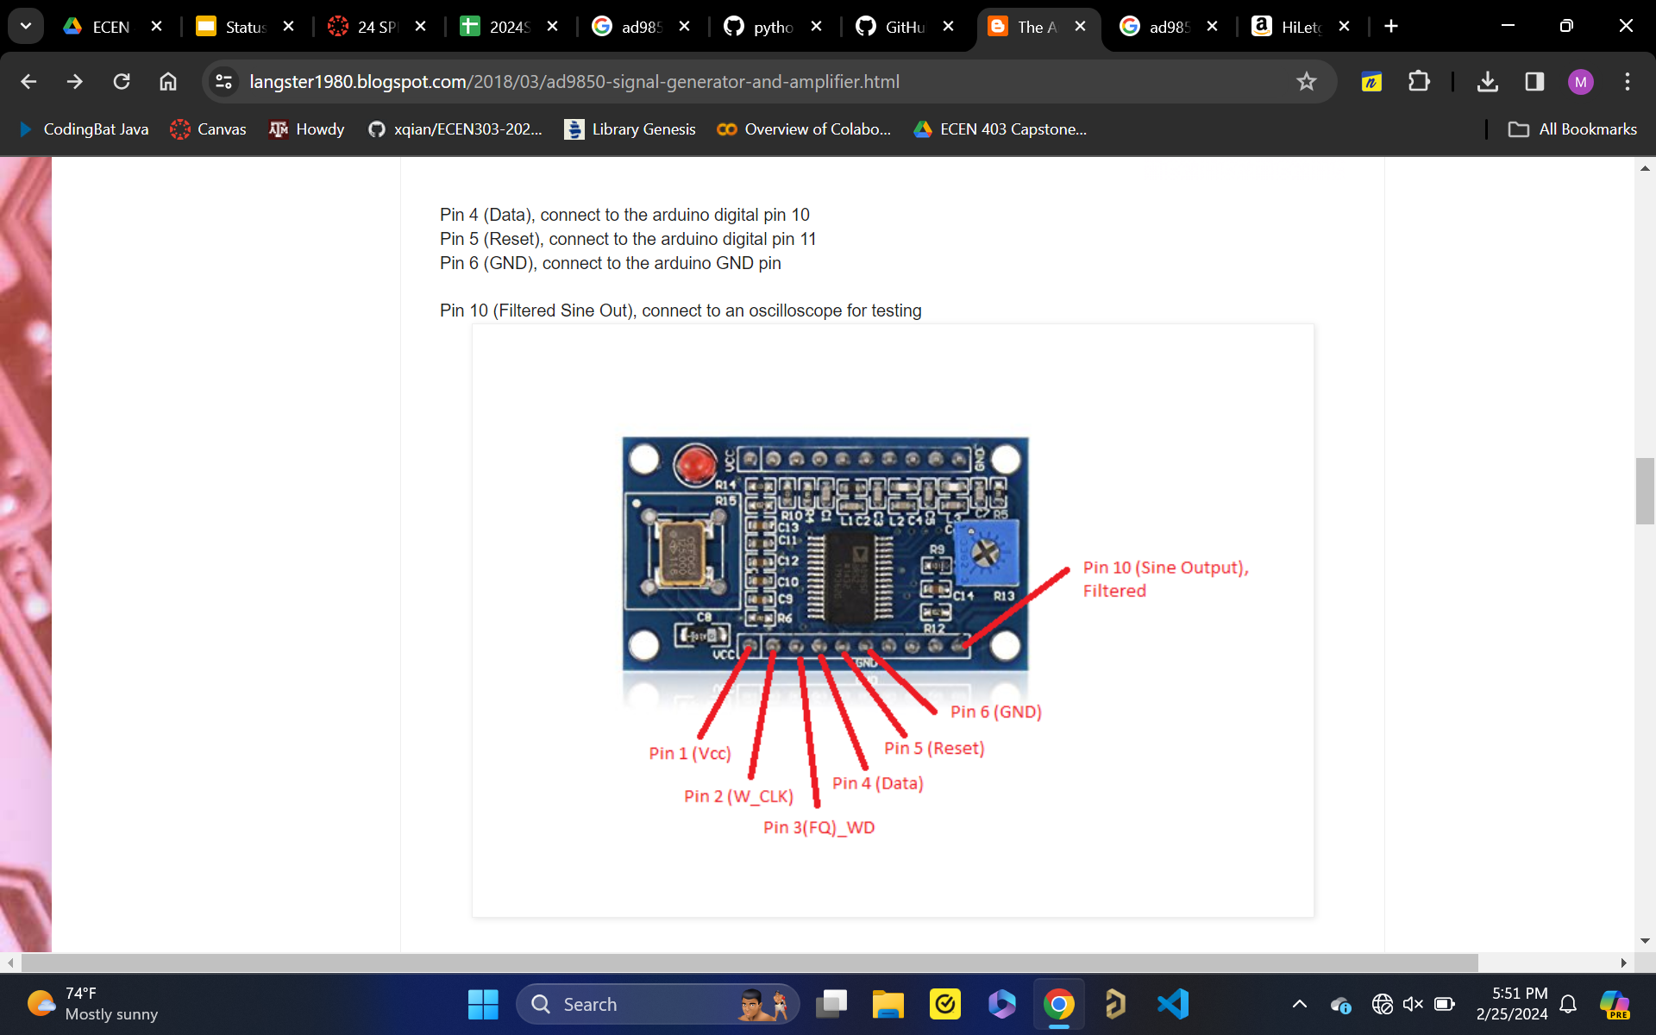
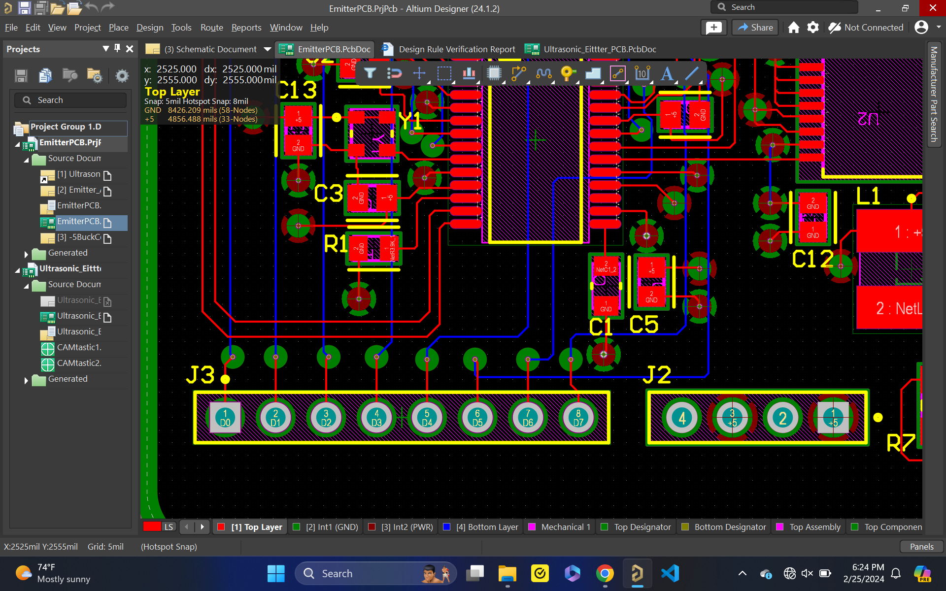
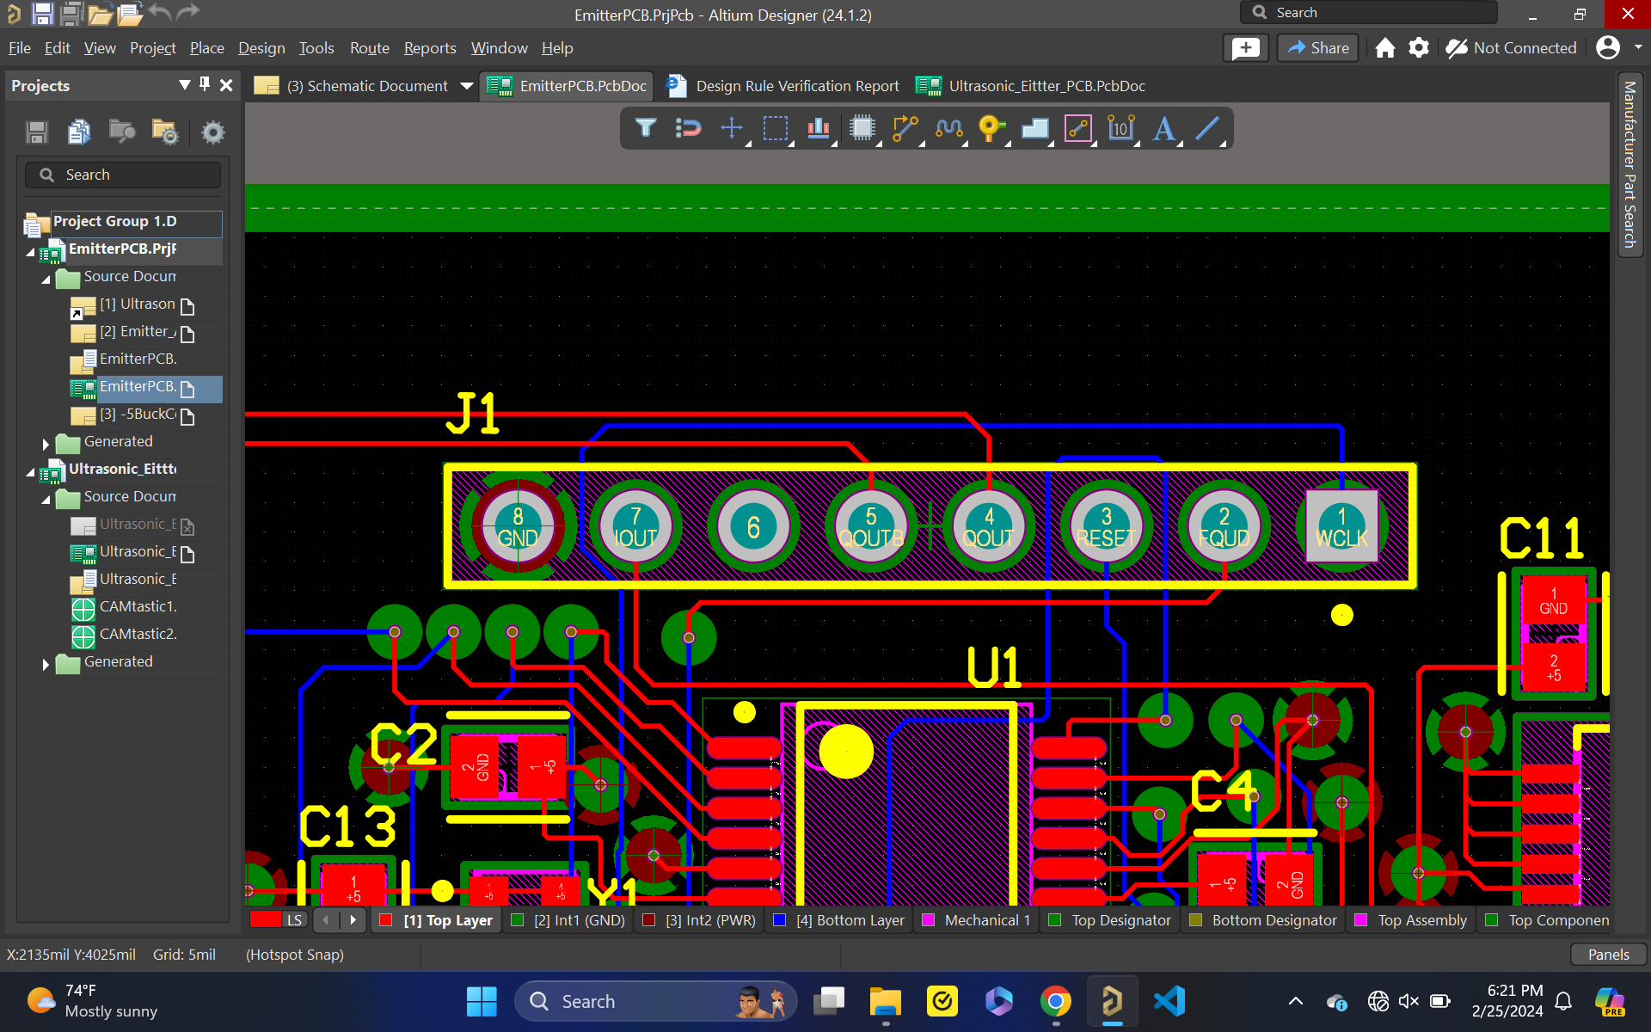
Melquisedec Ordonez
Backup board will and final board will communicate in the same manner, just need to swap connection to final board.

Slide 11
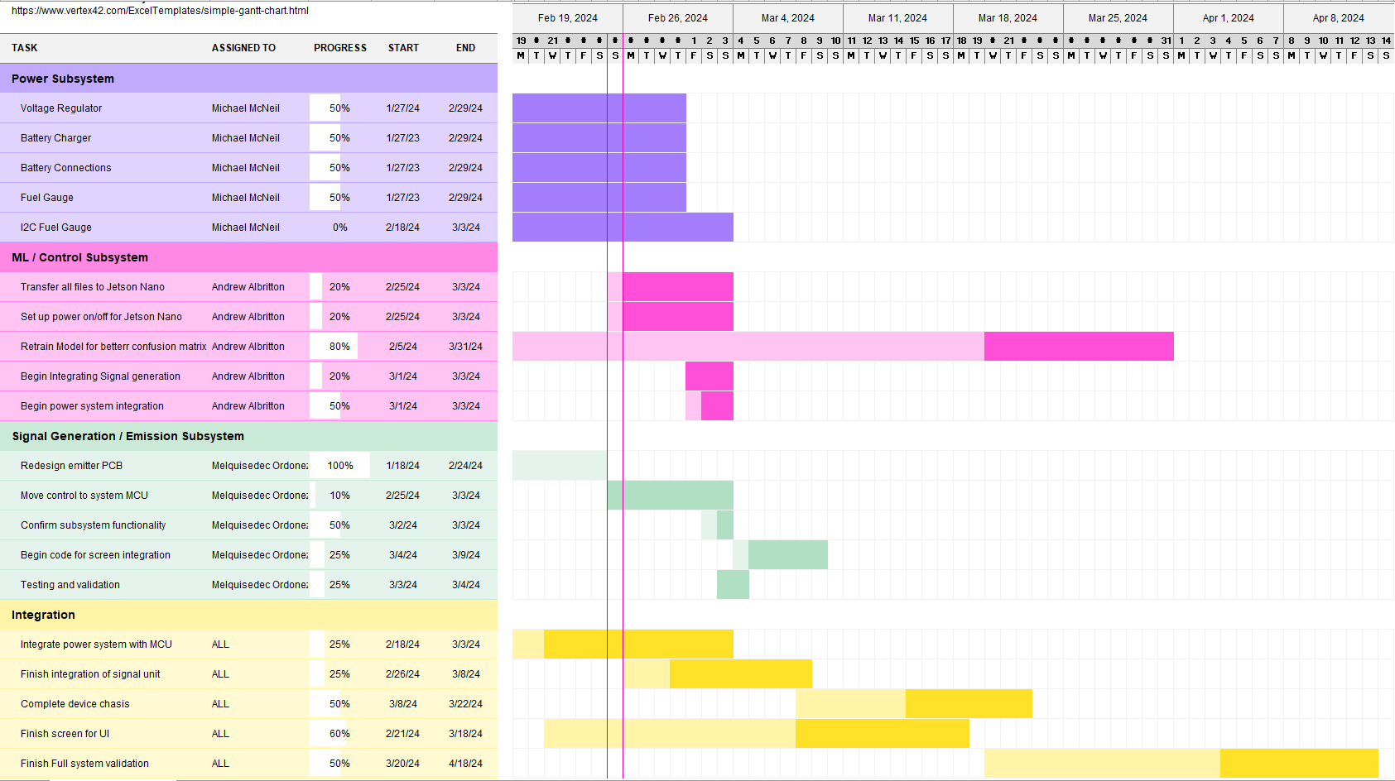
Execution Plan
Notes:
Michelle

Slide 12
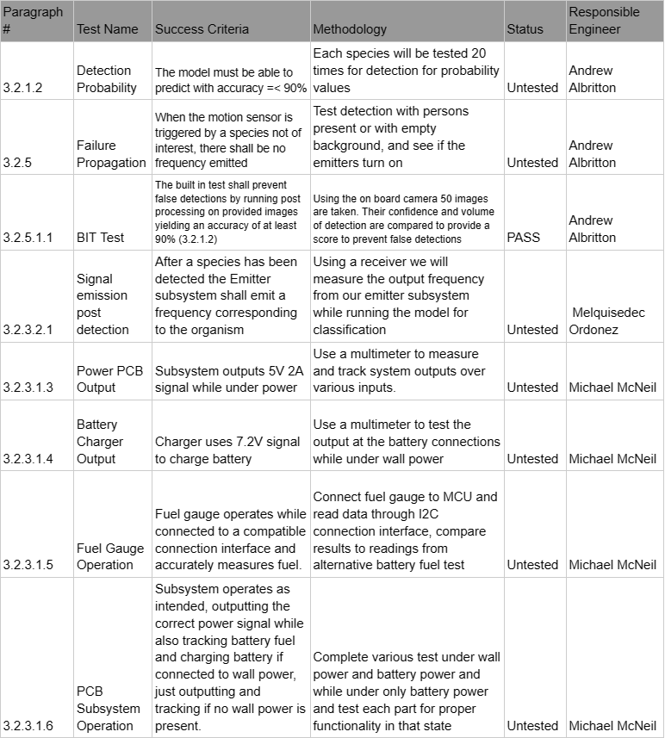
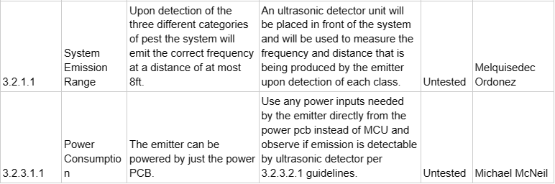
Validation Plan

Slide 13
Thank you, any questions?

